Slide 1
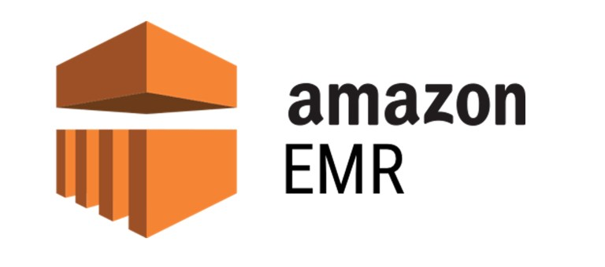

Slide 2

Topics
Data life cycle
What is EMR?
Basic of EMR
EMR Cluster
Exam tips

Slide 3
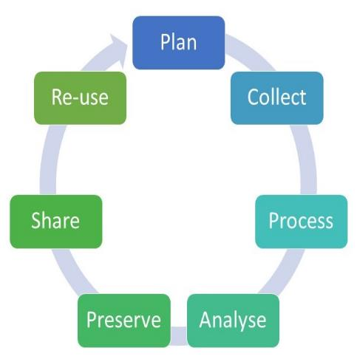
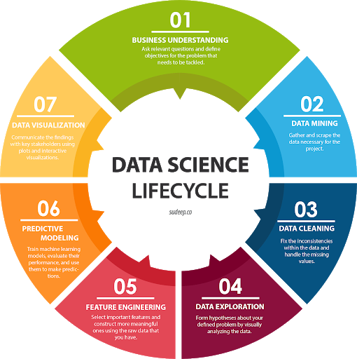
Data Life Cycle

Slide 4

What is EMR?
Amazon EMR (Elastic Map Reduce) is the industry - leading cloud big data platform for processing vast amounts of data using open-source tools such Apache Spark, Apache Hive, Apache HBase, Apache Flink, Apache Hudi, etc
With EMR, You can run petabyte-scale analysis at less than half the cost of traditional on-premises solutions and over three times faster than standard Apache Spark.
The Central component of Amazon EMR is the cluster. A Cluster is a collection of Amazon Elastic Compute Cloud (Amazon Ec2) instance.
Each instance in the cluster is called a node. Each node has a role within the cluster, referred to as the node type.
Amazon EMR also installs different software components on each node type, giving each node a role in a distributed application like Apache Hadoop.

Slide 5

The basics of EMR
You can configure a cluster to periodically archive the log files stored on the master node to Amazon S3.
This ensures the logs files are available after the cluster terminates, whether this is through normal shutdown or due to error.
Amazon EMR archives the logs files to Amazon S3 at five-minute intervals

Slide 6
EMR Cluster
Master Node:
A node that manages the cluster. The master node tracks the status of tasks and monitors the health of the cluster.
Every cluster has a master node.
Core node:
A node with software components that runs tasks and stores data in Hadoop Distributed File System (HDFS) on your cluster.
Multi-node cluster have at least one core node
Task node:
A node with software components that only runs tasks and does not store data in HDFS.
Task nodes are optional

Slide 7
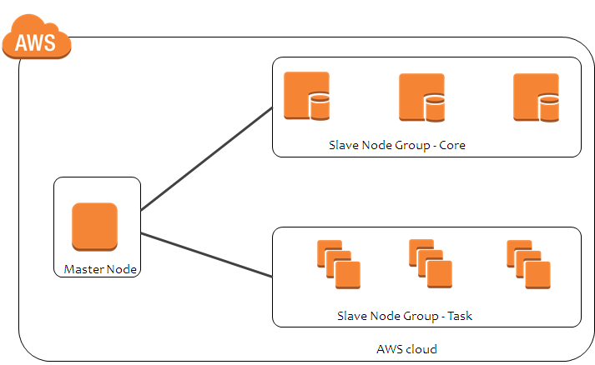
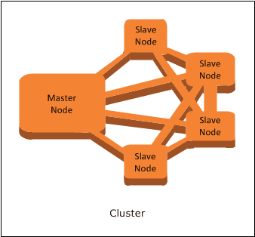
EMR Cluster

Slide 8
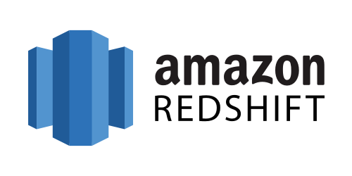

Slide 9

What is Redshift
Amazon Redshift is a fast and powerful, fully managed, petabyte-scale data warehouse service in the cloud.
Customer can start small for just $0.25 per hour with no commitment or upfront cost and scale to a petabyte or more for $1000 per terabyte per year, less than a tenth of most other data warehousing solutions.
Data warehousing databases use different type of architecture both from a database perspective and infrastructure layer

Slide 10
OLAP
OLAP transaction Example:
Revenue of a company country wise.
Covid vaccination done on daily bases state wise/country wise.
Sale price of Stock in 10 years
Climate change of city/state/country for last 10/20/50 years
Number of Flights Landed in Mumbai Airport in the month of Dec
Number of Flights departure from India from 2000-2020, year-wise, state wise stats

Slide 11
Basic of Redshift
Redshift Configuration
Single Node (160GB)
Multi-Node
Leader Node (manages client connections and receives queries)
Compute Node (store data and perform queries and computations). Up to 128 Compute Nodes.
Massively Parallel Processing
Amazon Redshift automatically distributes data and query load across all nodes.
Amazon Redshift makes it easy to add nodes to your data warehouse and enables you to maintenance fast query performance as your data warehouse grows.

Slide 12
Basic of Redshift
Advanced Compression
Columnar data stores can be compressed much more than row-based data stores because similar data is stored sequentially on disk.
Amazon Redshift employs multiple compression techniques and can often achieve significant compression relative to traditional relational data stores.
In addition, Amazon Redshift doesn't require indexes or materialized views and so uses less space than traditional database systems.
When loading data into an empty table, Amazon Redshift automatically samples your data and selects the most appropriate compression scheme

Slide 13
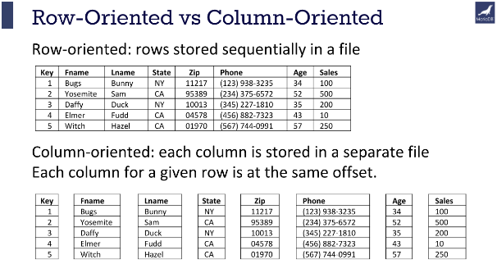
Basic of Redshift

Slide 14
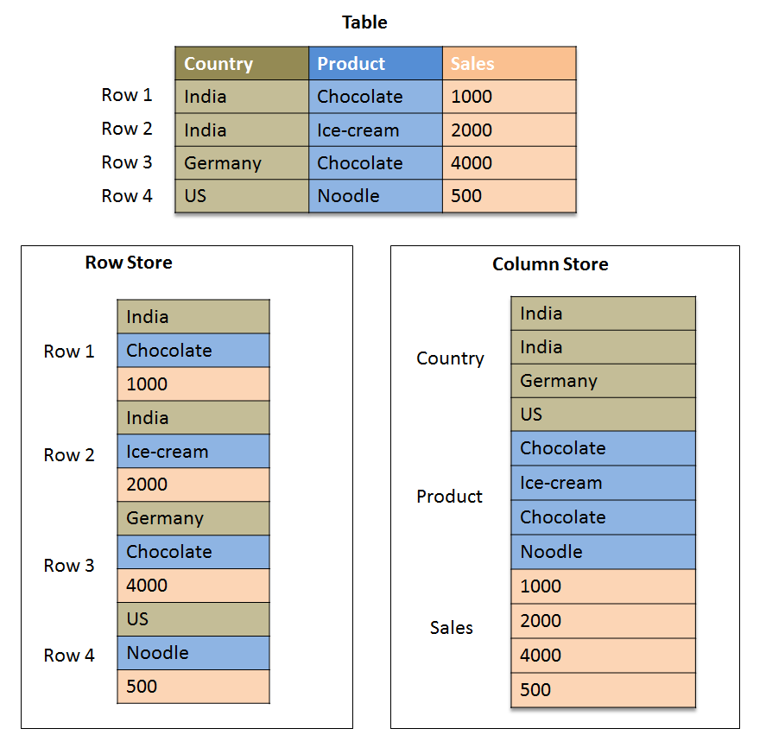
Basic of Redshift

Slide 15

Backups
Enable by default with a 1-day retention period
Maximum retention period is 35 days
Redshift always attempts to maintain at least three copies of your data (the original and replica on the compute nodes and a backup in Amazon S3)
Redshift can also asynchronously replicate your snapshots to S3 in another region for disaster recovery

Slide 16
Redshift Pricing
Redshift Pricing
Compute Node Hours (total number of hours you run across all your compute node for the billing period.
You are billed for 1 unit per node per hour, so a 3-node data warehouse cluster running persistently for entire month would incur 2160(3*24*30) instance hours;
Only compute node will incur charges)

Slide 17
Security Considerations
Encrypted in transit using SSL
Encrypted at rest using AES-256 encryption
By default, Redshift takes care of key management
Manage your own keys through HSM
AWS Key Management Service

Slide 18
Availability:
Currently RS only available in 1-AZ
Can restore snapshots to new AZ in the event of an outage

Slide 19

Exam Tips:
Amazon EMR is the industry - leading cloud big data platform for processing vast amounts of data using open-source tools
A Cluster is a collection of Amazon Elastic Compute Cloud (Amazon Ec2) instance. Each instance in the cluster is called a node.
Master Node:
A node that manages the cluster. The master node tracks the status of tasks and monitors the health of the cluster.
Core node:
A node with software components that runs tasks and stores data in Hadoop Distributed File System (HDFS) on your cluster.
Task node:
A node with software components that only runs tasks and does not store data in HDFS.

Slide 20
Exam Tips:
Redshift is used for business intelligence
Backups:
Enable by default with a 1-day retention period
Maximum retention period is 35 days
Redshift always attempts to maintain at least three copies of your data (the original and replica on the compute nodes and a backup in Amazon S3)
Redshift can also asynchronously replicate your snapshots to S3 in another region for disaster recovery

Slide 21
Thank you

